Slide 1
Lecture 08 Virtual Memory COMP1411: Introduction to Computer Systems
Dr. Mingsong LYU (呂鳴松)
Department of Computing,
The Hong Kong Polytechnic University
Spring 2023
Acknowledgement: These slides are based on the textbook (Computer Systems: A Programmer’s Perspective) and its slides.
These slides are only intended to use internally. Do not publish it anywhere without permission.

Slide 2
Main message
Problem: if a program requires 1GB main memory, but we have only 1MB physical main memory, how can execute the program?
1GB = 2³⁰B, 1MB = 2²⁰B, 1GB = 2¹⁰MB = 1024MB
Virtual memory, a technique that allows to fit the 1GB program into the 1MB physical main memory so that the program can execute

Slide 3
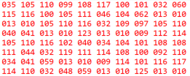
Program Image
program.c → program image (executable file)
#include <stdio.h>
int main()
{
printf(“hello, world\n”);
return 0;
}

Slide 4
Executing a program
Loading the program image into the main memory
Logical address → physical address
Starts from
0100
00
A
0100
A
01
B
0101
B
02
C
0102
C
03
D
0103
D
04
E
0104
E
05
F
0105
F
06
G
0106
G
07
H
0107
H
Program image
Main memory

Slide 5
Memory access in program execution
During execution, the CPU frequently goes to main memory to fetch data (instructions, data)
0100
A
mrmovq (%rax), %rbx
ADDR = 0103
0101
B
CPU
0102
C
0103
D
0104
E
0105
F
0106
G
0107
H
DATA = D
Main memory

Slide 6
The problem
The program image is too large to be fit into the main memory
0100
A
0101
B
0102
C
0103
D
0104
E
0105
F
G
？
0106
0107
H
…
…
…
Main memory
……
A large program

Slide 7
Basic idea: paging
Chunk the program image into virtual pages
Chunk the main memory into physical pages, also called frames
Each time, load a page into a specific frame of the main memory
00
A
B
C
D
Page 0
04
E
F
G
H
Frame 0
Page 1
08
I
J
K
L
Frame 1
Page 2
0C
M
N
O
P
Page 3

Slide 8
Basic idea: paging
Each time, load a page into a frame of the main memory
00
A
B
C
D
Page 0
0100
A
B
C
D
04
E
F
G
H
Frame 0
Page 1
0104
08
I
J
K
L
Frame 1
Page 2
0C
M
N
O
P
Page 3

Slide 9
Basic idea: paging
Each time, load a page into a frame of the main memory
00
A
B
C
D
Page 0
0100
A
B
C
D
04
E
F
G
H
Frame 0
Page 1
0104
E
F
G
H
08
I
J
K
L
Frame 1
Page 2
0C
M
N
O
P
Page 3

Slide 10
Basic idea: paging
If the memory is full, replace an old page with a new page
00
A
B
C
D
Page 0
0100
I
J
K
L
A
B
C
D
04
E
F
G
H
Frame 0
Page 1
0104
E
F
G
H
08
I
J
K
L
Frame 1
Page 2
0C
M
N
O
P
Page 3

Slide 11
Addressing problem
Page 2 will use the physical address that has been used by Page 0
00
A
B
C
D
Page 0
0100
I
J
K
L
A
B
C
D
04
E
F
G
H
Frame 0
Page 1
0104
E
F
G
H
08
I
J
K
L
Frame 1
Page 2
0C
M
N
O
P
Page 3

Slide 12
Addressing problem
Issue 1: needs to remember which page is put into which frame
Page table: a mapping from virtual pages to frames
00
A
B
C
D
0100
I
J
K
L
Page 0
Frame 0
04
E
F
G
H
0104
E
F
G
H
Page 1
Frame 1
08
I
J
K
L
Page 2
Virtual page | Frame
1 | 1
2 | 0
0C
M
N
O
P
Page 3
Page table

Slide 13
Addressing problem
Issue 2: if the memory is full, and a new page will be loaded, which old page to replace?
Similar to cache
Many replacement policies, leveraging locality

Slide 14
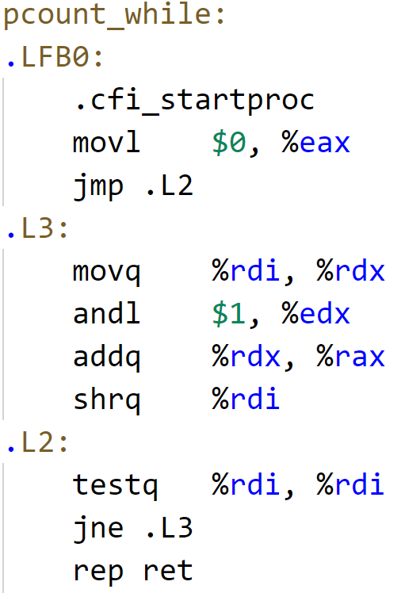
Address translation
If I want to use a data item in my executable file, which has been loaded to main memory, how do I know the physical address of the data item?
0x00
A (8B)
8B
0x08
16B
B (8B)
24B
0x10
C (8B)
0x18
D (8B)
The address of a data item in the executable file is an offset from the beginning of the file

Slide 15
Address translation
To access “G” in physical main memory
That is, to determine the physical address of “G”
Which page is “G” in? → page 1
Where is page 1 loaded to? → frame 3
What’s G’s offset in page 1? → 0x10 away for the start of page 1
Physical address = start address of frame 3 + G’s offset
0x0100 + 0x10 = 0x0110
Go to main memory with address 0x0110, you will get data item G
0x00
A
0x0100
E
0x08
B
Frame 3
0x0108
F
Page 0
Virtual page | Physical frame
0 | 4
1 | 3
0x10
C
0x0110
G
0x18
D
0x0118
H
0x20
E
0x0120
A
Page 1
0x28
F
Frame 4
0x0128
B
0x30
G
0x0130
C
0x38
H
0x0138
D

Slide 16
Address translation
General steps
Virtual address (x) → page number (x) + offset (x)
Check page table, page number (x) → frame number (x)
Frame number (x) → starting address (x)
Starting address (x) + offset (x) = physical address (x)
If we want to access “b” which is in page 2. When we check the page table, do not find page 2 (page fault)
=> page 2 has not been loaded into physical memory
=> load page 2 into main memory
=> if no space, kick out some old page, and update the page table
=> do address translation for b, get b’s physical address
=> fetch b from main memory to CPU

Slide 17
Address translation
Address translation is done by a special hardware in CPU called Memory Management Unit (MMU)
Address translation is too complex and slow
We need a fast worker to do the job
CPU Chip
2
Memory
MMU
Page table address
Page
table
1
Page table entry
CPU
Virtual address
3
Physical address
4
Data
5

Slide 18
Address translation
Accessing page table in main memory is slow
Translation lookaside buffer (TLB): a cache for page table in the CPU chip
CPU Chip
TLB
4
2
PTE
VPN
Memory
Page
table
1
MMU
3
CPU
VA
PTEA
PA
5
Data
6

Slide 19
Things to remember
Contemporary computer systems allows a program to require a memory space larger than the physical memory
The problem is solved by virtual memory
Program memory content is paged, hardware memory is paged
Share the hardware memory pages (frames)
Address translation is needed to ensure correct data access

Slide 20
Thank You

Slide 21
QUIZ 2
Time: 16:40 - 17:15, 15-Mar-2023
A. Only one signal attempt of submission;
B. Any submission is considered valid ONLY IF it is submitted before the due time 17:15 on the BlackBoard server, INSTEAD OF the time on your own computer.
C. The questions will be shown one by one. You need to manually navigate to the next question after you finish the current one. Of course, you can navigate back to change your answer.
D. If you accidentally close the quiz page, do not worry, you can enter the quiz again, as long as the timer does not expire and you have not submitted your answers manually.
E. If you forget to submit your answer manually, your incomplete answers will be automatically submitted when the timer expires.
F. It is OK if you want to submit your answers manually before the timer expires. In this case, you can NOT enter the quiz again to change answers, as there is only a single attempt of submission.
G. Always remember to save your answer often.
Most multiple answer questions do not have partial mark.

